Slide 1

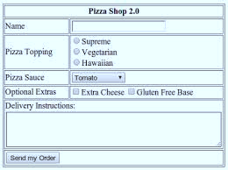
HTML Form

Slide 2

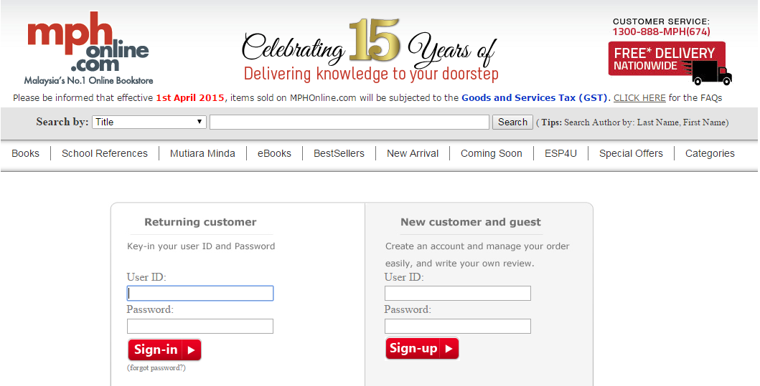
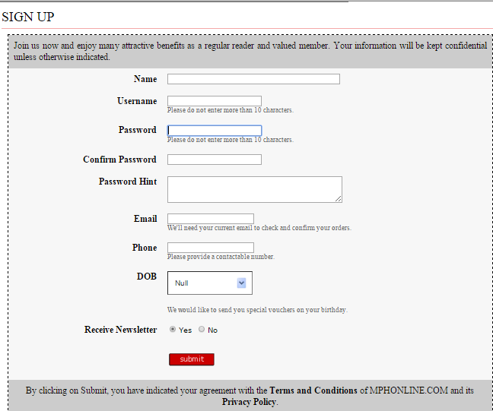
HTML Forms Entering User Data from a Web Page

Slide 3
HTML Forms
HTML forms allow users to enter data into a web page.
Create a form block with:
<form></form>

Slide 4
The Form Element
The form element acts as a container for handling the data submitted by clients.
It consists of several attributes as follows.
Attribute | Value | Description
action | URL | Specifies the path to send form data when the form is submitted
method | get post | Specifies the HTTP method to use when sending form data.
name | text | Specifies the name of a form
target | _blank _self _top | Specifies the location to display the response that is received after submitting the form

Slide 5
Form element - Example
The “method" attribute tells how the form data should be sent – via GET or POST request
<form name="myForm" method="post" action="path/to/some-script.php">
...
</form>
The "action" attribute tells where the form data should be sent

Slide 6
The Input Element
The input specifies an input field where the user can enter data. Input elements are used within a form element.
It consists of the following attributes.
Attribute | Description
type | Specifies the type of input
name | Specifies the name of input
value | Specifies the initial value of input
size | Specifies the width, in characters, of input

Slide 7
The Input Type
Input Type | Description
Text box | A box in which anything can be typed (e.g: letters, numbers) via the keyboard. Default size: 20 characters
Password box | Password field. The computer displays bullets or asterisks.
Radio buttons | Best used when you want the user to select one of a limited number choices.
Check boxes | Allow users to select more than one option.
Drop-down list | Create a pop-up list from which any one option may be selected. Best used when the screen space for list options is limited.
Multiple selections | A drop-down list that allows users to select more than one options.
Text area | Provides a box where the user may type large amounts of text.
Hidden | Allows an input which is hidden from the user. Programmers used this input for special programming purposes.
Submit | Inserts a button that submits data to the server.
Reset | Inserts a button that clears all entries the user entered into the form.

Slide 8
Form with input element - Example
Simple HTML form with two input fields and a submit button:
<html><body> <form action="Customer_form.php" method="get" name="customer" > Name: <input type="text" name="myname"><br> E-mail: <input type="text" name="email"><br> <input type="submit"> </form> </body></html>

Slide 9
Getting Data from a Request
When user clicks on the Submit button, the data from an HTTP request (HTML form) is submitted and stored in PHP variables in the specified page (e.g: Customer_form.php) on a web server.
Two commonly used methods for a request-response between a client and a server:
GET – requests data from a specified resource.
POST – submits data to be processed to a specified resource.

Slide 10
Using GET Method and $_GET Array
When HTML form uses the GET method, the values are stored in a $_GET array.
By using GET method, these values are passed as part of the URL that requests the page.
Example:
http://localhost/Training/Customer_form1.php?myname=Ehsan&email=ehsan@gmail.com
GET method is used when the request is for a page that gets data from a database server.
GET request can be bookmarked and remain in the browser history.
GET request should never be used when dealing with sensitive data.
GET requests have length restriction.

Slide 11
Using POST Method and $_POST Array
POST method is more appropriate for working with sensitive data
It does not append parameters to the end of the URL.
The values from the form that uses POST method are stored in a $_POST array.
The POST method is used when;
the request is for a page that writes data to a database server.
executing the request multiple times may cause problems.
you do not want to include the parameters in the URL for security reasons.
you need to transfer more than 4 KB of data.

Slide 12
HTML5 Input Types
New input types
color
date
time
email
month
number
search
url
tel

Slide 13
HTML5 Input Types
Examples
<input type="color" name="favcolor" value="#ff0000">
<input type="date" name="birthday">
<input type="time" name="userTime">
<input type="email" name=“myEmail">
<input type="month" name="birthdaymonth">
<input type="number" name="quantity" min="1" max="5">
<input type="search" name="googleSearch">
<input type="url" name="homepage">
<input type="tel" name="userTel">

Slide 14
Form with POST method and more input fields
<body>
<form action="Custhp" method="post" name="customer" >
<h1><i></b><b>ILMU ONLINE BOOKSTORE</b></i></h1><hr>
<h3><u>Customer Registration</u></h3>
<h5>Your Personal Details</h5>
Name: <input type="text" name="myname" size="50"><br><br>
Address: <input type="text" name="add" size="100"><br><br>
State:
<select name="state">
<option value="Johor">Johor</option>
<option value="Kedah>Kedah</option>
<option value="Kelantan">Kelantan</option>
<option value="Perak">Perak</option>
</select><br><br><hr>
<h5>Your Username & Password</h5>
Username: <input type="text" name="username"><br><br>
Password: <input type="password" name="username" size="10"><br><br><hr>
Subscribe newsletter? <input type = "radio" name = "subscribe" value ="yes">Yes
<input type = "radio" name = "subscribe" value = "no" >No <p>
Favourite book category :
<input type = "checkbox" name = "book1" value = "FICTION"> Fiction
<input type = "checkbox" name = "book2" value = "HISTORY"> History
<input type = "checkbox" name = "book3" value = "COMIC"> Comic <p>
<input type="submit" value = "Submit This Form ">
<input type = "reset" value = "Clear All">
</form></body>

Slide 15
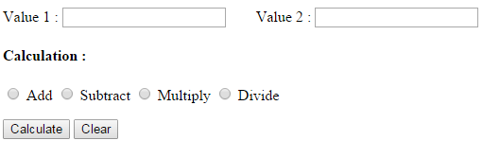
HTML Forms – Exercise
Write an HTML code to produce the following form.

Slide 16
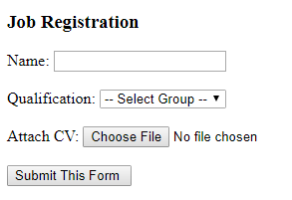
HTML Forms – Exercise 2
Write an HTML code to produce the following form.

